Slide 1
Consensus Protocols
Smita Kulkarni-pai

Slide 2
Proof-of-Work (PoW) in Blockchain
What is Proof-of-Work (PoW)?
Distributed trust
Used while adding new block in chain
Arbitrary difficulty settings
The mining process
Checking validity of block
Valid Block=Block Hash < Difficulty Hash
calculate suitable nonce

Slide 3
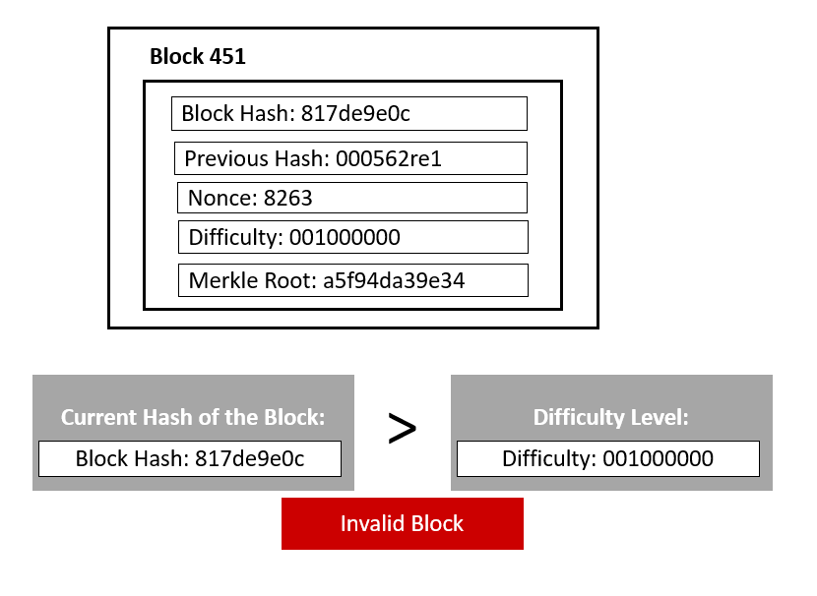
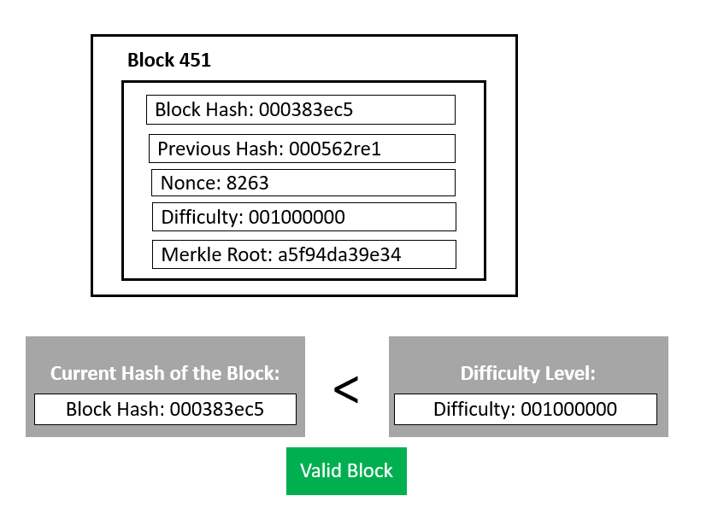
Proof-of-Work (PoW) in Blockchain
Let’s say, Harry’s block Hash: 817de9e0c Difficulty Hash: 001000000 Nonce: 8263 For, this, Block Hash > Difficulty Hash, which is considered invalid. 817de9e0c1 > 001000000 Harry will change the nonce until he gets the first 3 digits as zeroes. After continuously changing nonce for hours, he finally got the hash. Harry’s block Hash: 000383ec5 Difficulty Hash: 001000000 Nonce: 6778 Now, the difficulty threshold got achieved. Block Hash < Difficulty Hash.
Example of Proof-of-Work (PoW)?

Slide 4
Proof-of-Work (PoW) in Blockchain
Benefits of PoW
The following are the advantages of the Proof-of-Work (PoW) mechanism:
A hard-to-find solution. Yet, easy verification.
Initial consensus mechanism, PoW doesn’t need the initial staking of coins before mining. One can start with 0 coins, and it will go only positive.
Easy to implement in comparison with other blockchain consensus mechanisms.
It is fault-tolerant. It means the failure of one component will not shut down the whole blockchain network.
Give miners an earning opportunity for adding a block.
PoW is the oldest, most trusted, and most popular consensus protocol.

Slide 5
Proof-of-Work (PoW) in Blockchain
Limitations of PoW
The following are the disadvantages of the Proof-of-Work (PoW) mechanism:
A lot of energy gets wasted as only one miner can eventually add its block.
It requires heavy computation power hence massive resource and energy consumption.
A 51% attack risk on the network. The controlling entity can acquire 51% to dominate the network.
Spread environmental hazards using additional machinery.
Pow is a time and energy-consuming process.
It needed heavy expenses for hardware.
Risk of denial of service attacks by intruders.

Slide 6
Proof-of-Stake (PoS) in Blockchain
What Is Proof-of-Stake (PoS)?
Validators with stake of coins
Privilege to earn transaction fees
Random selection of validators
Security through community control
Validators receive transaction fees as rewards

Slide 7
Proof of Burn(PoB) in Blockchain
What Is a Proof of Burn?
Alternative to PoW to address energy consumption issue
“burn” virtual currency tokens
write blocks in proportion to the coins burnt
Can burn native currency or alternate coins
Receive rewards in native currency

Slide 8
Proof of Burn(PoB) in Blockchain
Example of Proof of Burn
POB implementation can be customized.
For example, Slimcoin, a virtual currency network that uses POB, allows a miner to burn coins that not only gives them the right to compete for the next block but also gives them the chance to receive blocks during a longer time period, for at least a year.
Essentially, Slimcoin’s POB implementation combines three algorithms: POW, POS, and the core POB concept.
The process of burning coins utilizes POW; the more coins one burns the more chances one has to mine, thus ensuring POS; and the whole ecosystem follows the POB concept.

Slide 9
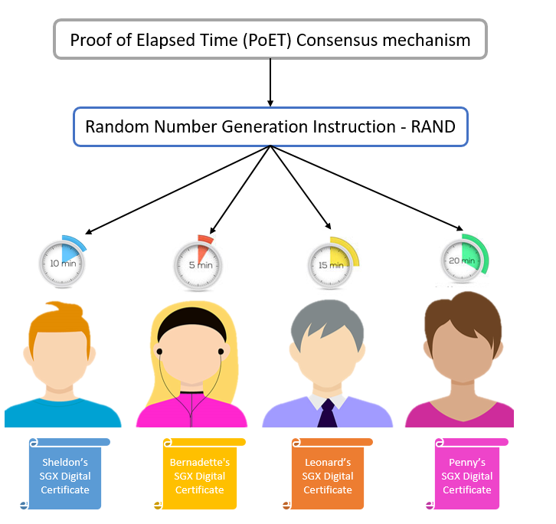
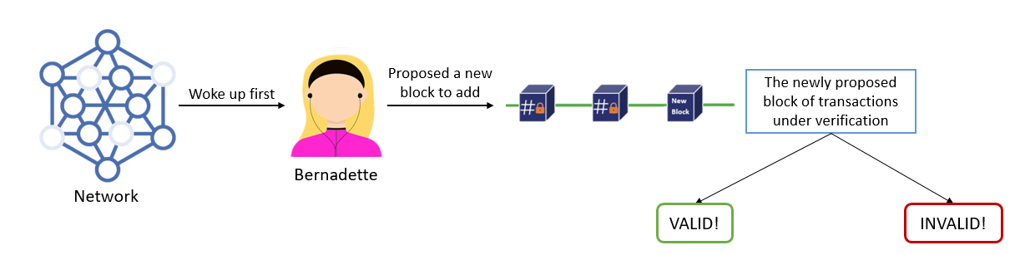
Proof of Elapsed Time (PoET) in Blockchain
What Is a Elapsed Time (PoET)?
Effective use of random waiting time
Use of fair lottery system to select validators

Slide 10
Proof of Elapsed Time (PoET) in Blockchain
Benefits of Proof of Elapsed Time (PoET)
Following are the advantages of the PoET consensus mechanism:
PoET can go up to a million transactions per second.
It is highly energy-efficient and easily scalable.
It’s a block generation consensus algorithm, unlike proof of stake (PoS).
PoET is for privately controlled spaces like business organizations.
It ensures the same opportunity for network participants with time object and activation.
As it’s a permissioned blockchain network, the process of selecting validators ensures network security against cyber attacks.

Slide 11
Proof of Elapsed Time (PoET) in Blockchain
Limitations of Proof of Elapsed Time (PoET)
The following are the disadvantages of the PoET consensus mechanism:
PoET is a permissioned and closed network, unlike Bitcoin and Ethereum.
The mechanism highly depends on tools by Intel technology which might raise compatibility issues with other tools later.

Slide 12
Proof of Practical Byzantine Fault Tolerance (PBFT) in Blockchain
What Is a Practical Byzantine Fault Tolerance (PBFT) ?
Solution to Byzantine Generals’ Problem
Byzantine fault tolerant algorithm
Types of Byzantine failures
Fail-stop failure:
Arbitrary node failure

Slide 13
Proof of Practical Byzantine Fault Tolerance (PBFT) in Blockchain
How does pBFT work?
The pBFT consensus happens in the following five steps:
The client makes a request and sends it to the primary node.
The primary node broadcasts the request to all the secondary(backup) nodes. It is called the pre-prepare phase.
Then every node (primary and secondary) sends a prepare message to all other nodes.
Once every node receives (n/3)+1(n/3)+1prepare messages, it sends a commit message to all other nodes and commits the changes made by the client's request.
Once every node receives (n/3)+1(n/3)+1 commit messages from other nodes, it sends a reply to the client.

Slide 14
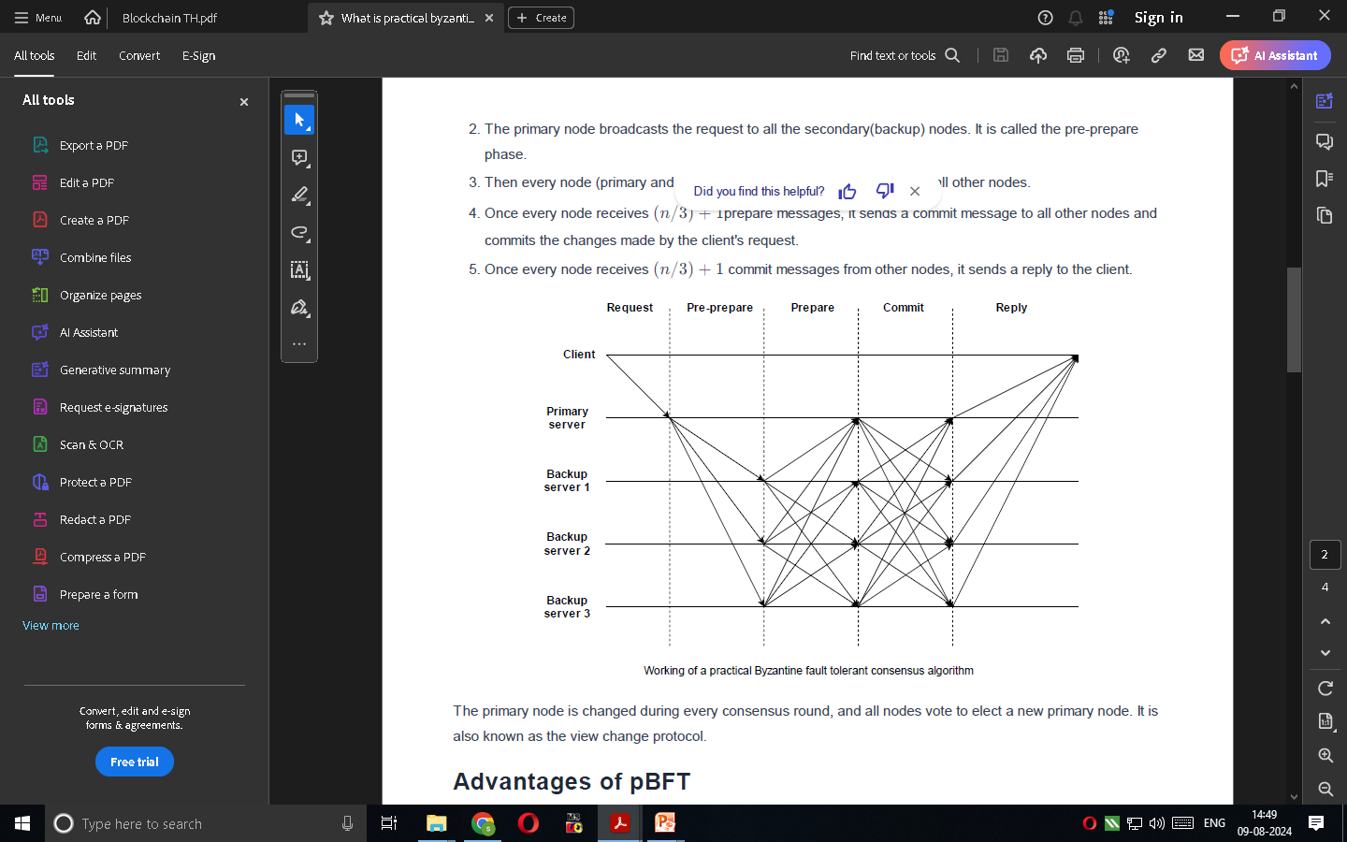

Slide 15
https://www.investopedia.com/terms/p/proof-burn-cryptocurrency.asp
https://www.investopedia.com/terms/p/proof-stake-pos.asp
https://www.shiksha.com/online-courses/articles/proof-of-work-pow-in-blockchain/

